Slide 1
What & Why Functional Programming in C# & F#
OOP makes code understandable by encapsulating moving parts. FP makes code understandable by eliminating moving parts.
— Michael Feathers
(author of Working with Legacy Code)
Riccardo Terrell – Silicon Valley Code Camp 2014

Slide 2
Agenda
History and influence of Functional Programming
What is Functional Programming
Functional Programming characteristics
Why Functional Programming
Functional vs Imperative Programming

Slide 3
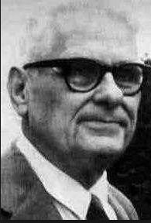
History
ISWIM
λ
1958
1966
LISP
ML
1930-ish
1962
APL
1973
F#
FP
2005
Clojure
1977
2007
2003
Scala
Erlang
1986
Ocaml
Haskell
1996
1988

Slide 4
Functional Programming Influence
Continue Evolution of GC – Lisp ~1958
Generics – ML ~ 1973
In early 1994, support for lambda, filter, map, and reduce was added to Python
List comprehension - Linq in C# 3.0 and Java 8
First-class functions were also introduce Visual Basic 9, C# and C++ 11
Java 8 supports lambda expressions as a replacement for anonymous classes
Is Lazy Evaluation is part of the main stream languages such as C#
Type Inference, example is the “var” keyword in C#
Programming in a functional style can also be accomplished in languages that aren't specifically designed for functional programming, Lots of modern languages have elements from FP

Slide 5
Objectives
Use functions as building block and composition to solve complex problem with simple code
Immutability and Isolation are your best friends to write concurrent application
Concurrency and reliability are becoming more and more required, FP will help you!
Functional and imperative styles should NOT stand in opposition …
… they should COEXIST
Poly-paradigm programming is more powerful and effective than polyglot programming

Slide 6


FP vs OOP the Paradigm-Switch
Functional Programming may look scary for an object-oriented developer because of all the strange buzzwords like Functor, Referential Transparency, Monads, etc., but they are really just unfamiliar terms.
Object-oriented programming can be a scary one with all its concepts, e.g. polymorphism, encapsulation,
inheritance, covariance, etc.
?@#?%!

Slide 7
FP OOP Key Concepts
Functional Programming is different in many ways from a standard imperative language, but there are a few major differences that are particularly important to understand:
Function-oriented
not
object-oriented
Expressions rather than Statements
Immutable rather than mutable

Slide 8
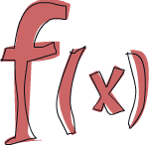
What is "Functional Programming?"
Functional programming is just a style, is a programming paradigm
that treats computation as the evaluation of functions and avoids
state and mutable data…
“Functions as primary building blocks” (first-class functions)
programming with “immutable” variables and assignments, no state
Programs work by returning values instead of modifying data

Slide 9

What is "Functional Programming?"
Functional programming is so called because a program consists entirely of functions.
Declarative
λ
First class
Higher-Order
Functions
Immutability
… is all about functions! Identifying an abstraction and building a function, use existing functions to build more complex abstractions, pass existing functions to other functions to build even more complex abstractions

Slide 10
Functional characteristics
Higher Order Function & Pure Function
Immutability
Composition
Curry & Partial Application

Slide 11
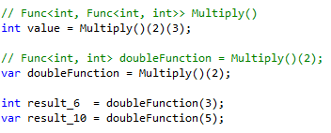
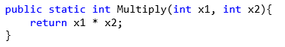
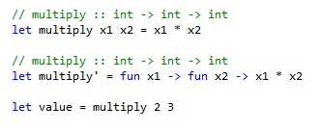
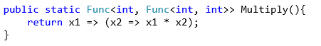
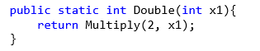
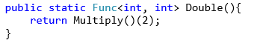
Higher-Order functions
A higher-order function is a function that takes another function as a parameter, or a function that returns another function as a value, or a function which does both.

Slide 12
Pure Functions - Properties and Benefits
A function always gives the same output value for a given input value
I can then cache the result
A Pure Function has no side effects
Pure functions can be executed in parallel
The function does not rely on any external state
Increased readability and maintainability
Pure functions can more easily isolated
easier testing and debugging

Slide 13
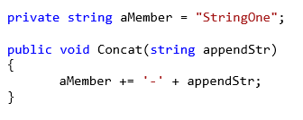
Pure Functions - Properties and Benefits
Bad!

Slide 14
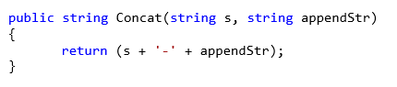
Pure Functions - Properties and Benefits
Good!

Slide 15
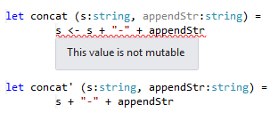
Pure Functions - Properties and Benefits
Very Good!

Slide 16
Side Effects
Side effects aren’t bad…

Slide 17

Unwanted Side Effects are Evil!
Side effects aren’t bad…
unwanted side effects are EVIL
and the root of many bugs!
One of the biggest advantages with functional programming is that the order of execution of “side effect free functions” is not important.
… “side effect free functions” are easy to parallelize

Slide 18
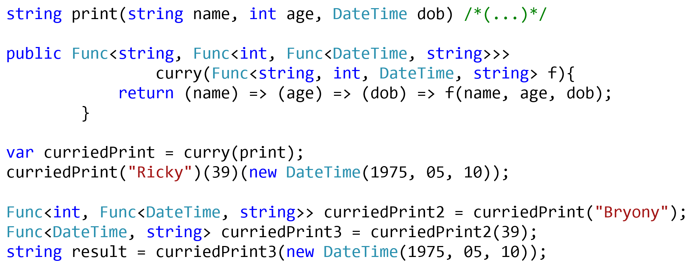
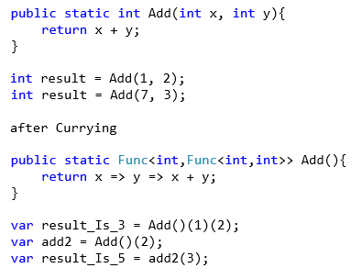
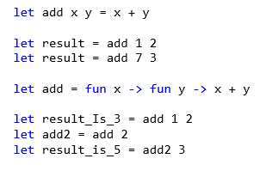
Currying
Curry is a technique in which a function is applied to its arguments one at a time, with each
application returning a new function
that accepts the next argument
Higher-order function enable
Partial Application and Currying

Slide 19
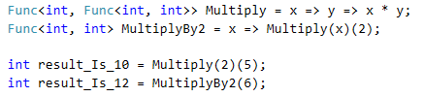
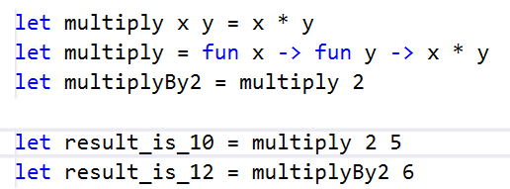
Partial Application
Partial Application refers to the process of fixing a number of arguments to a function, producing another function of smaller arity
With both currying and partial application, you supply argument values and return a function that’s invokable with the missing arguments. But currying a function returns the next function in the chain, whereas partial application binds argument values to values that you supply during the operation, producing a function with a smaller arity

Slide 20

Immutability
Immutability is very important characteristic of FP but mostly is about transformation of state… … Immutable data forces you to use a “transformational” approach
When you’re writing programs using immutable types, the only “thing a method can do is return a result, it can’t modify the state of any objects
Immutable data makes the code predictable is easier to work
Prevent Bugs
Concurrency is much simpler, as you don’t have to worry about using locks to avoid update conflicts
Automatic thread-safe, controlling mutable state in concurrency is very hard

Slide 21
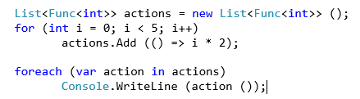
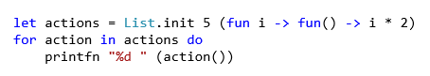
Immutability
Mutable values cannot be captured by closures!
Bad!
Good!

Slide 22
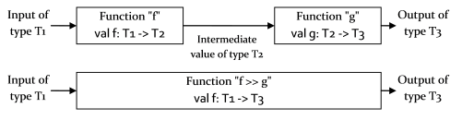
Function Composition
Function Composition - Building with composition. Composition is the 'glue' that allows us build larger systems from smaller ones. This is the very heart of the functional style. Almost every line of code is a composable expression. Composition is used to build basic functions, and then functions that use those functions, and so on.
Composition — in the form of passed parameters plus first-class functions

Slide 23
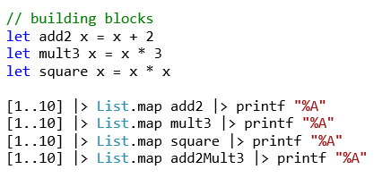
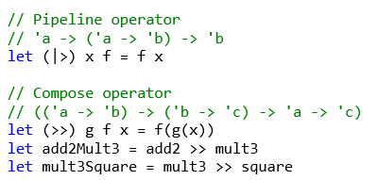
Using functions as building blocks
A well-known principle of good design is to create a set of basic operations and then combine these building blocks in various ways to build up more complex behaviors

Slide 24
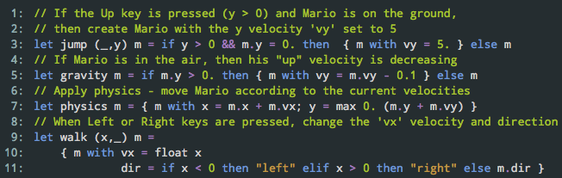
Compose Mario
Mario game sample, based on functional reactive Elm script (http://elm-lang.org/edit/examples/Intermediate/Mario.elm)
The functions that depend on keyboard take the current keyboard state as the first argument. This is represented as a tuple int*int (dir) consisting of x and y directions.
The step function of the game takes previous Mario value and returns a new one. It is composed from 4 functions that represent different aspects of the game.

Slide 25



Slide 26
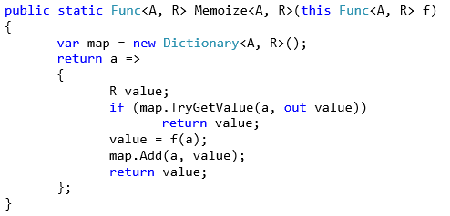
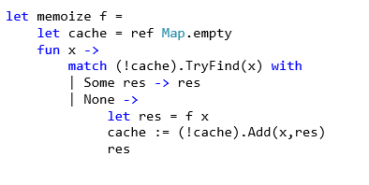
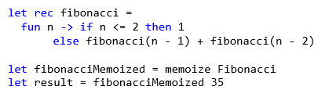
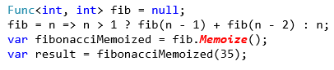
Memoization
Memoization enables automatic caching of recurring function-return values.

Slide 27

Lazy Evaluation - Strict & Non-Strict Evaluation
Lazy evaluation deferral of expression evaluation for as long as possible until absolutely needed
Languages can be categorized as strict (eagerly evaluating all expressions) or lazy (deferring evaluation)
Strict evaluation always fully evaluates function arguments before invoking the function
Lazy evaluation does not evaluate function arguments unless their values are required to evaluate the function call itself

Slide 28
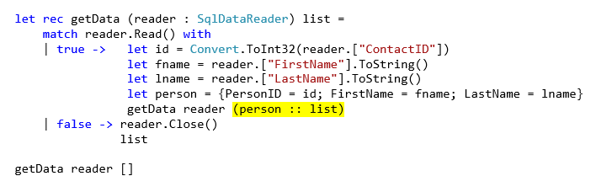
Recursion is the new iteration
In functional programming “iteration” is ~usually~ accomplished via recursion
Recursive function invoke themselves, Tail recursion is optimized by compiler avoiding to maintain a stack ~stack over flow!

Slide 29
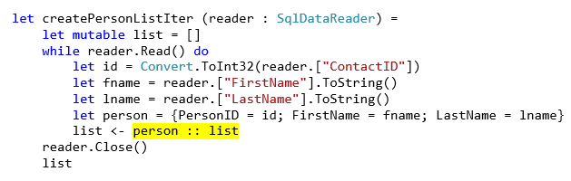
Recursion is the new iteration
In functional programming “iteration” is ~usually~ accomplished via recursion
B a d!
Notes:
Recursion to do not modify the list

Slide 30
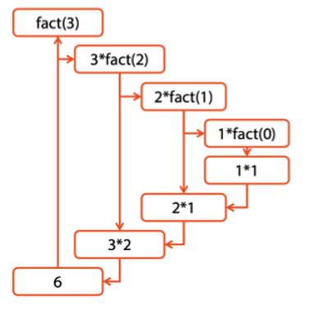
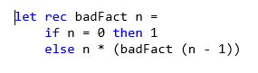
Recursion
StackOverFlow Exception

Slide 31
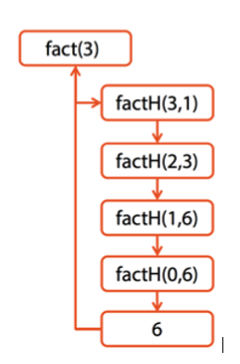

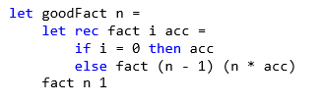
Tail Recursion

Slide 33

Why Functional Programming?
Notes:
Many people find functional programming elegant or even beautiful, but that’s hardly a good reason to use it in a commercial environment.
Elegance doesn’t pay the bills, sad to say.
One of the big reason for coding in a functional style is that it makes you and your team more productive.

Slide 34

Why Functional Programming?
Changes the way you think about programming and problem solving
Functional Programming promotes Composition and Modularity
Simple Code for Complex Problems
Declarative programming style
Concurrency, FP is easy to parallelize
Locking vs. immutable memory
Conciseness, less code (no null checking)
Correctness & Reduced bugs (immutability)
Rapid Prototyping

Slide 35
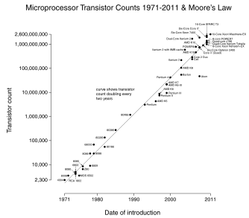
Concurrency
Modern computers come with multiple processors, each equipped with multiple cores, but the single processor is slower than used to be! Moore’s law (http://en.wikipedia.org/wiki/Moore's_law)
… to achieve great performances the application must be leveraging a Concurrent Model

Slide 36

Concurrency
There is a problem…
the free lunch is over
Programs are not doubling in speed every couple of years for free anymore
We need to start writing code to take advantage of many cores

Slide 37
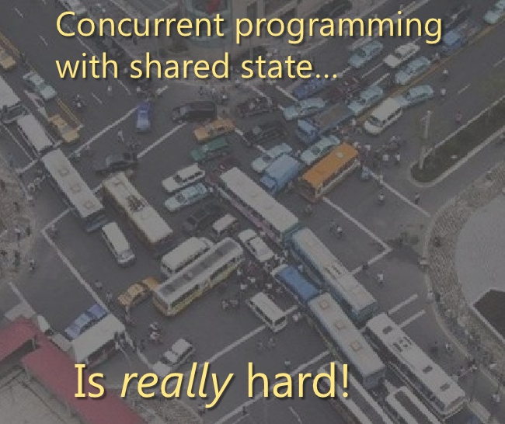
Concurrency… jams to avoid!
Parallel, asynchronous, concurrent, and reactive programs bring many challenges because these programs are nearly always nondeterministic
This makes debugging/testing challenging
Deadlocking
Not easy to program
Concurrency is a double-edged sword

Slide 38

Concurrency
Imperative and traditional programming styles gives us bad headaches
It’s difficult to turn existing sequential code into parallel code
Using shared state and locks is difficult
different threads can change the same data at the same time

Slide 39

Concurrency
Functional programming feels good:
Thanks to the immutability (and isolation), we avoid introducing race conditions and we can write lock-free code.
Using a declarative programming style we can introduce parallelism into existing code easily. We can replace a few primitives that specify how to combine commands with version that executes commands in parallel

Slide 40
Concurrent Model Programming
IMMUTABILITY +
ISOLATION +
DECLARATIVE PROGRAMMING =
------------------------------------------------
BEST CONCURRENT MODEL PROGRAMMING
An Agent is an independent computational entity which contains a queue, and receives and processes messages
It provides immutability and isolation
(it enforces coarse-grained isolation through message-passing)

Slide 41
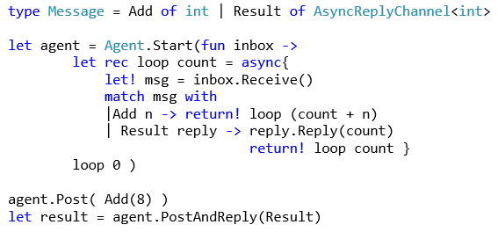
What does an Agent look like?

Slide 42
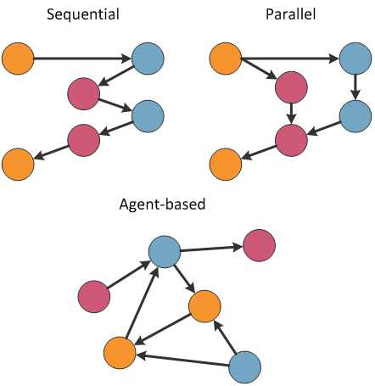
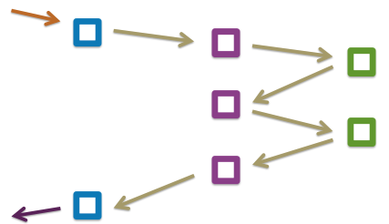
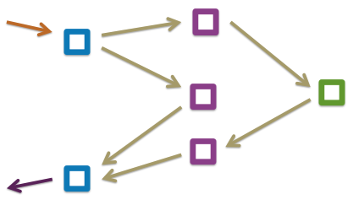
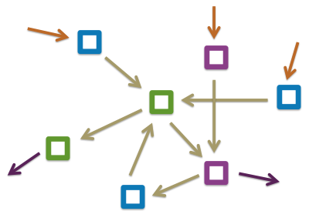
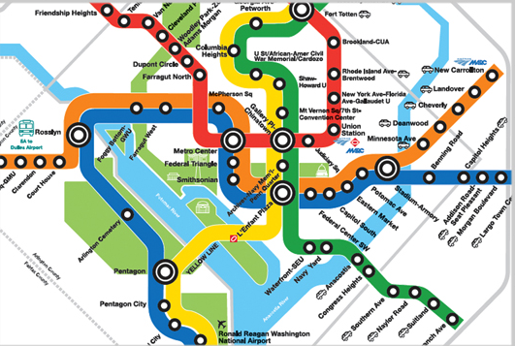
Agent Model
What does a system of actors look like?

Slide 43
Pipeline Processing
Pipeline according to Wikipedia:
A pipeline is a set of data processing elements connected in series, so that the output of one element is the input of the next one. The elements of a pipeline are often executed in parallel or in time-sliced fashion; in that case, some amount of buffer storage is often inserted between elements

Slide 44
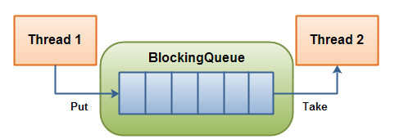
Agent Async-BoundedQueue

Slide 45
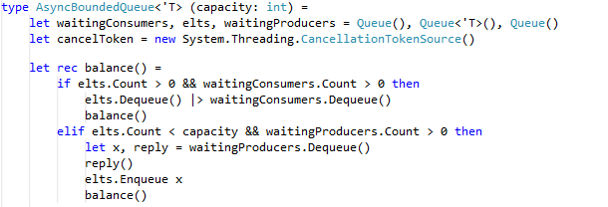
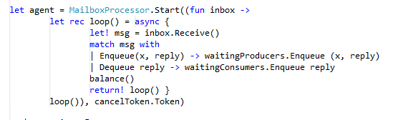
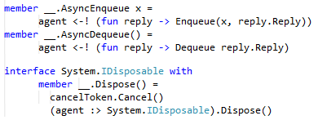
Agent Async-BoundedQueue

Slide 46
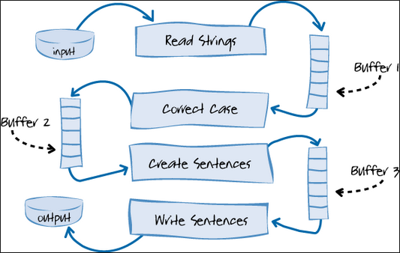
Pipeline Processing
Values processed in multiple steps
Worker takes value, processes it, and sends it
Worker is blocked when source is empty
Worker is blocked when target is full
Steps of the pipeline run in parallel

Slide 48
When Functional Programming?
NOW!

Slide 49
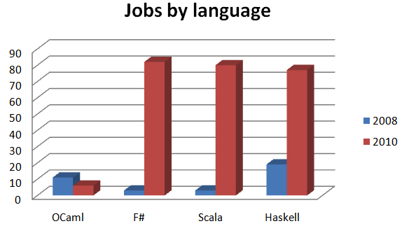
Functional Job Trend
Functional languages are sprouting not just on the JVM where the two most interesting new languages are Scala and Clojure, but also on the .NET platform, where F# is a first-class citizen
http://www.itjobswatch.co.uk

Slide 50

Wrap-Up
Use functions as building block and composition to solve complex problem with simple code
Immutability and Isolation are your best friends to write concurrent application
Concurrency and reliability are becoming more and more required, FP will help you!
Functional and imperative styles should NOT stand in opposition but…
…they should COEXIST
Poly-paradigm programming is more powerful
and effective than polyglot programming

Slide 51
Q & A ?
The tools we use have a profound (and devious!) influence on our thinking habits, and, therefore, on our thinking abilities.
-- Edsger Dijkstra

Slide 52
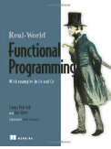
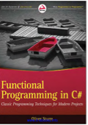
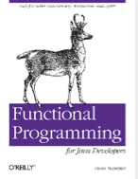
References
Why Functional Programming Matters (John Hughes) http://www.cs.kent.ac.uk/people/staff/dat/miranda/whyfp90.pdf
http://rosettacode.org

Slide 53

How to reach me
github.com/DCFsharp meetup.com/DC-fsharp/ @DCFsharp rterrell@microsoft.com

